Slide 1
Database Design: Logical Models: Normalization and The Relational Model
University of California, Berkeley
School of Information
IS 257: Database Management
IS 257 – Fall 2006

Slide 2
Announcements
I will be away next week
Instead we will have an informal workshop to work on issues of choosing and designing your personal Databases
IS 257 – Fall 2006

Slide 3
Lecture Outline
Review
  Conceptual Model and UML
Logical Model for the Diveshop database
Normalization
Relational Advantages and Disadvantages
IS 257 – Fall 2006

Slide 4
Lecture Outline
Review
Logical Design for the Diveshop database
Normalization
Relational Advantages and Disadvantages
IS 257 – Fall 2006

Slide 5
DiveShop ER Diagram
Customer
No
DiveCust
1
Destination
Name
Customer
No
ShipVia
Destination
no
n
ShipVia
DiveOrds
n
1
ShipVia
Dest
n
1
1
Destination
no
1
Destination
Order
No
Site No
n
Sites
Order
No
n
1
1
DiveItem
Site No
n
1/n
BioSite
ShipWrck
Item
No
n
Species
No
n
Site No
1
1
BioLife
DiveStok
Item
No
Species
No
IS 257 – Fall 2006

Slide 6
Lecture Outline
Review
  Conceptual Model and UML
Logical Model for the Diveshop database
Normalization
Relational Advantages and Disadvantages
IS 257 – Fall 2006

Slide 7
Database Design Process
Application 1
Application 2
Application 3
Application 4
External
Model
External
Model
External
Model
External
Model
Application 1
Conceptual
requirements
Application 2
Conceptual
requirements
Conceptual
Model
Logical
Model
Internal Model
Application 3
Conceptual
requirements
Application 4
Conceptual
requirements
IS 257 – Fall 2006

Slide 8
Logical Model: Mapping to a Relational Model
Each entity in the ER Diagram becomes a relation.
A properly normalized (next time) ER diagram will indicate where intersection relations for many-to-many mappings are needed.
Relationships are indicated by common columns (or domains) in tables that are related.
We will examine the tables for the Diveshop derived from the ER diagram
IS 257 – Fall 2006

Slide 9
DiveShop ER Diagram
Customer
No
DiveCust
1
Destination
Name
Customer
No
ShipVia
Destination
no
n
ShipVia
DiveOrds
n
1
ShipVia
Dest
n
1
1
Destination
no
1
Destination
Order
No
Site No
n
Sites
Order
No
n
1
1
DiveItem
Site No
n
1/n
BioSite
ShipWrck
Item
No
n
Species
No
n
Site No
1
1
BioLife
DiveStok
Item
No
Species
No
IS 257 – Fall 2006

Slide 10
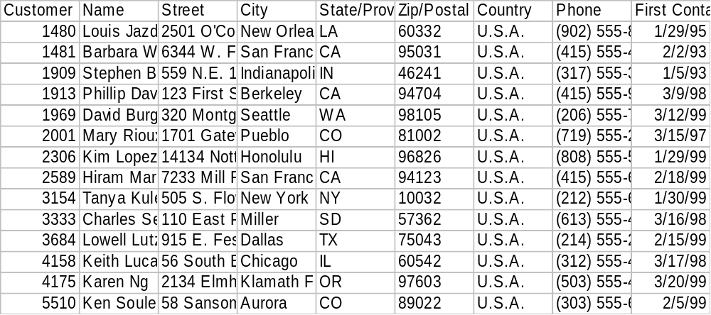
Customer = DIVECUST
IS 257 – Fall 2006

Slide 11
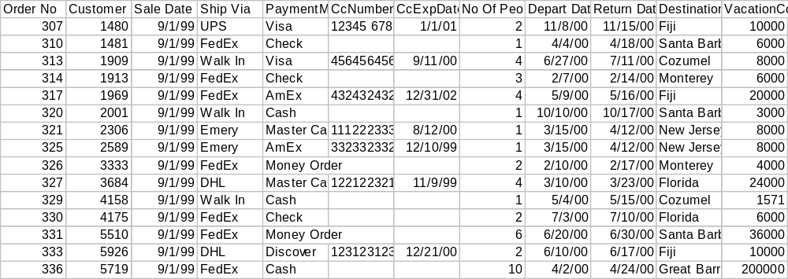
Dive Order = DIVEORDS
IS 257 – Fall 2006

Slide 12
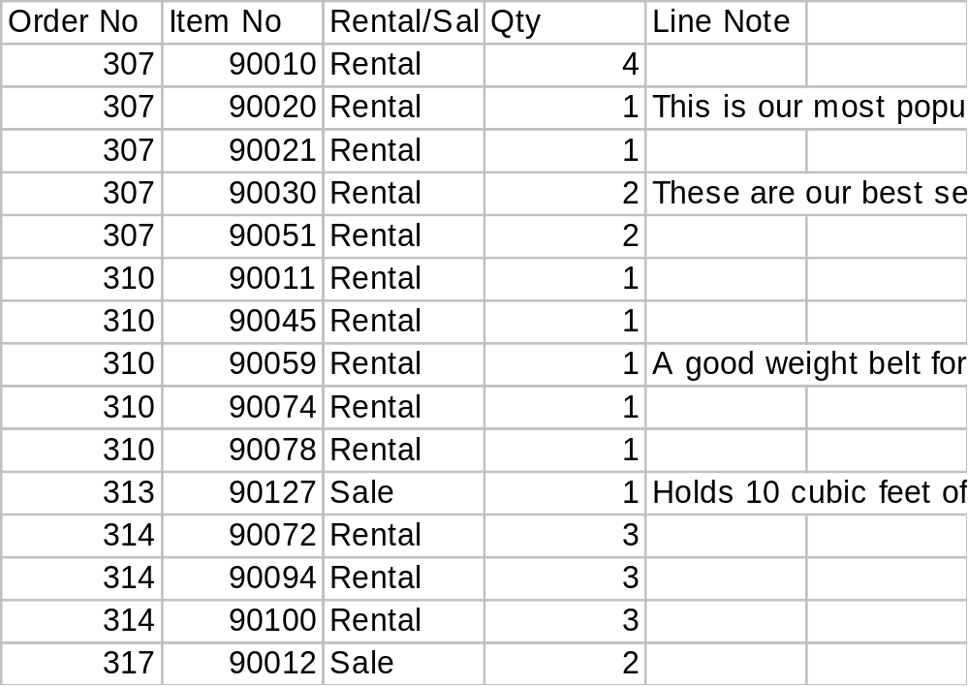
Line item = DIVEITEM
IS 257 – Fall 2006

Slide 13
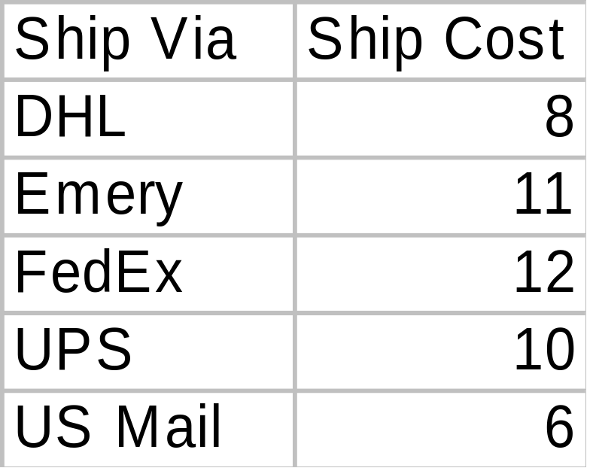
Shipping information = SHIPVIA
IS 257 – Fall 2006

Slide 14
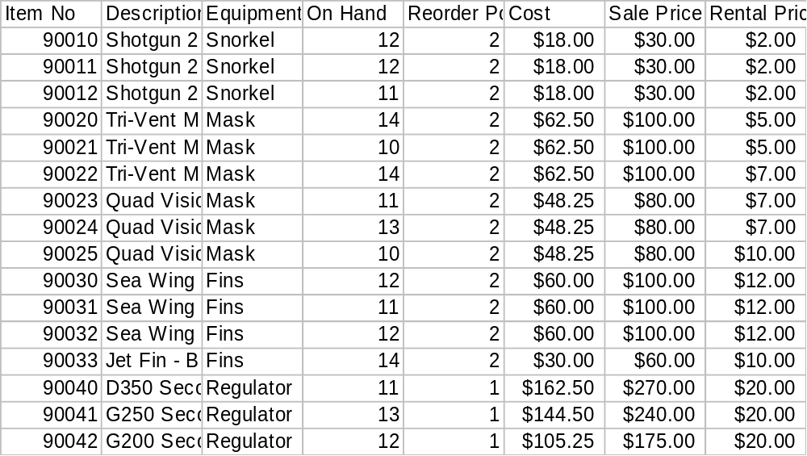
Dive Equipment Stock= DIVESTOK
IS 257 – Fall 2006

Slide 15
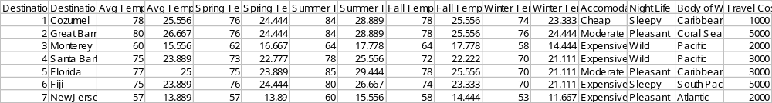
Dive Locations = DEST
IS 257 – Fall 2006

Slide 16
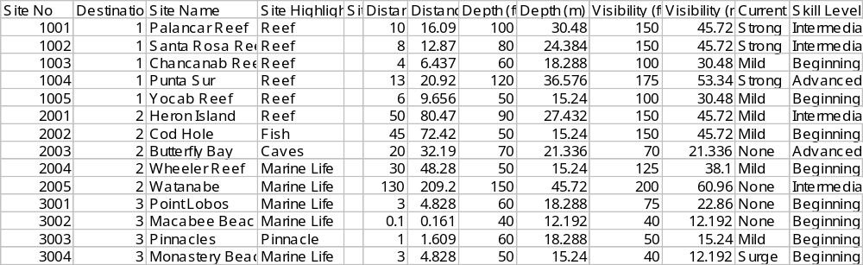
Dive Sites = SITE
IS 257 – Fall 2006

Slide 17
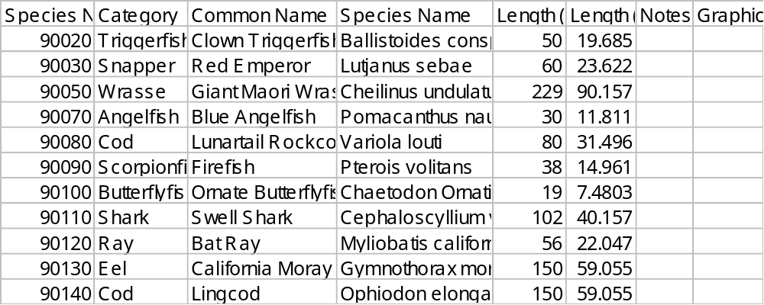
Sea Life = BIOLIFE
IS 257 – Fall 2006

Slide 18
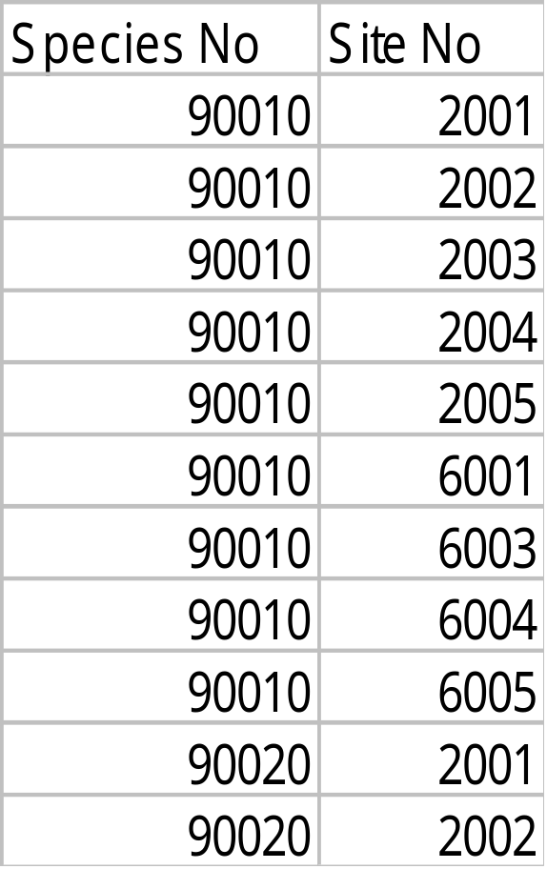
BIOSITE -- linking relation
IS 257 – Fall 2006

Slide 19
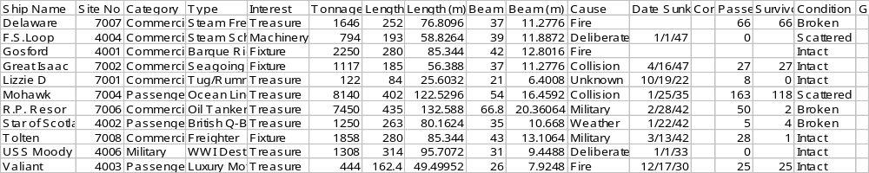
Shipwrecks = SHIPWRK
IS 257 – Fall 2006

Slide 20
Mapping to Other Models
Hierarchical
  Need to make decisions about access paths
Network
  Need to pre-specify all of the links and sets
Object-Oriented
  What are the objects, datatypes, their methods and the access points for them
Object-Relational
  Same as relational, but what new datatypes might be needed or useful (more on OR later)
IS 257 – Fall 2006

Slide 21
Lecture Outline
Review
Logical Model for the Diveshop database
Normalization
Relational Advantages and Disadvantages
IS 257 – Fall 2006

Slide 22
Normalization
Normalization theory is based on the observation that relations with certain properties are more effective in inserting, updating and deleting data than other sets of relations containing the same data
Normalization is a multi-step process beginning with an “unnormalized” relation
  Hospital example from Atre, S. Data Base: Structured Techniques for Design, Performance, and Management.
IS 257 – Fall 2006

Slide 23
Normal Forms
First Normal Form (1NF)
Second Normal Form (2NF)
Third Normal Form (3NF)
Boyce-Codd Normal Form (BCNF)
Fourth Normal Form (4NF)
Fifth Normal Form (5NF)
IS 257 – Fall 2006

Slide 24
Normalization
Unnormalized Relations
First normal form
Functional dependencyof nonkey attributes on the primary key - Atomic values only
No transitive dependency between nonkey attributes
Second normal form
Third normal form
Boyce-
Codd and
Higher
All determinants are candidate keys - Single multivalued dependency
Full Functional dependencyof nonkey attributes on the primary key
IS 257 – Fall 2006

Slide 25
Unnormalized Relations
First step in normalization is to convert the data into a two-dimensional table
In unnormalized relations data can repeat within a column
IS 257 – Fall 2006

Slide 26
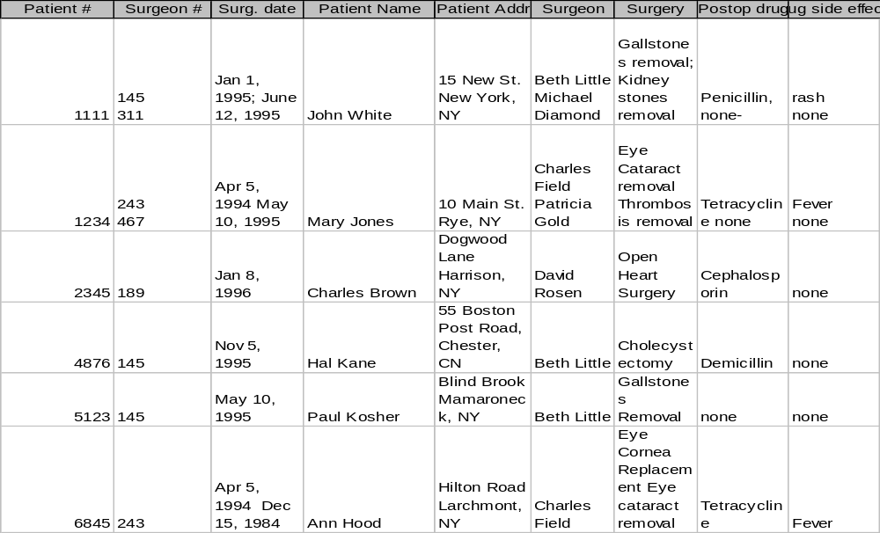
Unnormalized Relation
IS 257 – Fall 2006

Slide 27
First Normal Form
To move to First Normal Form a relation must contain only atomic values at each row and column.
  No repeating groups
  A column or set of columns is called a Candidate Key when its values can uniquely identify the row in the relation.
IS 257 – Fall 2006

Slide 28
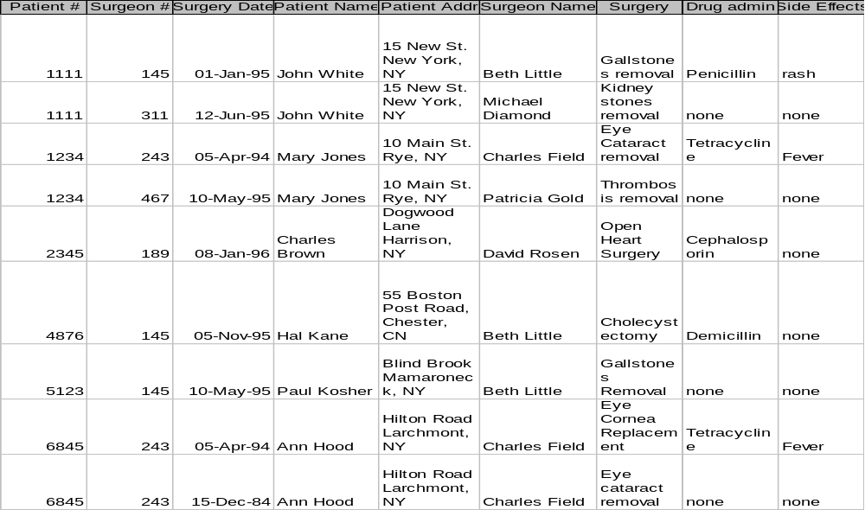
First Normal Form
IS 257 – Fall 2006

Slide 29
1NF Storage Anomalies
Insertion: A new patient has not yet undergone surgery -- hence no surgeon # -- Since surgeon # is part of the key we can’t insert.
Insertion: If a surgeon is newly hired and hasn’t operated yet -- there will be no way to include that person in the database.
Update: If a patient comes in for a new procedure, and has moved, we need to change multiple address entries.
Deletion (type 1): Deleting a patient record may also delete all info about a surgeon.
Deletion (type 2): When there are functional dependencies (like side effects and drug) changing one item eliminates other information.
IS 257 – Fall 2006

Slide 30
Second Normal Form
A relation is said to be in Second Normal Form when every nonkey attribute is fully functionally dependent on the primary key.
  That is, every nonkey attribute needs the full primary key for unique identification
IS 257 – Fall 2006

Slide 31
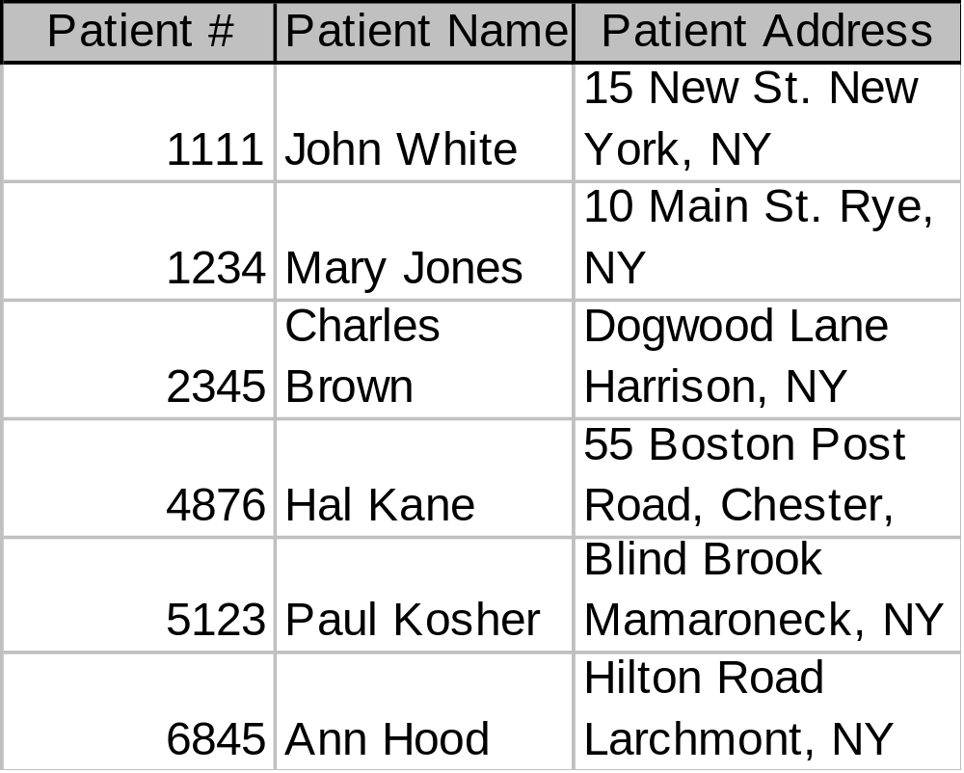
Second Normal Form
IS 257 – Fall 2006

Slide 32
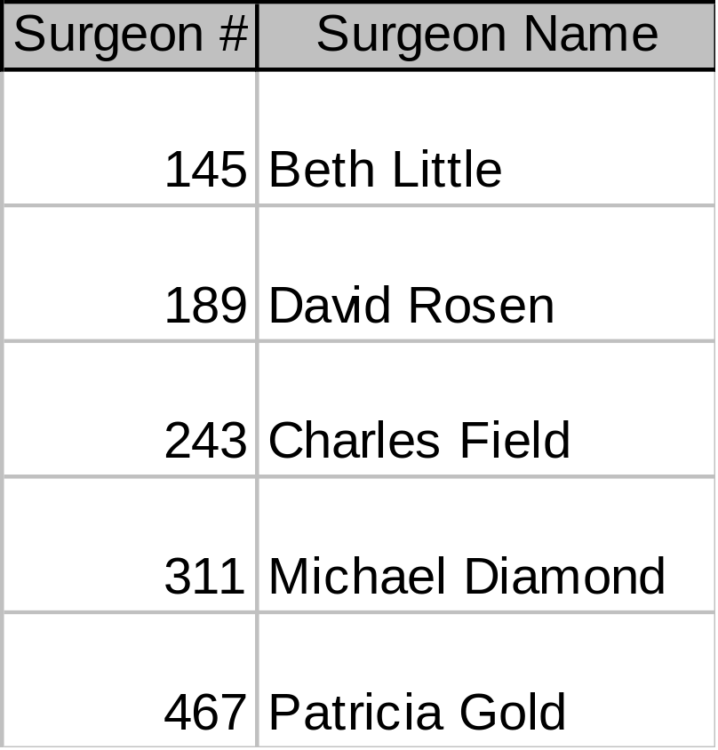
Second Normal Form
IS 257 – Fall 2006

Slide 33
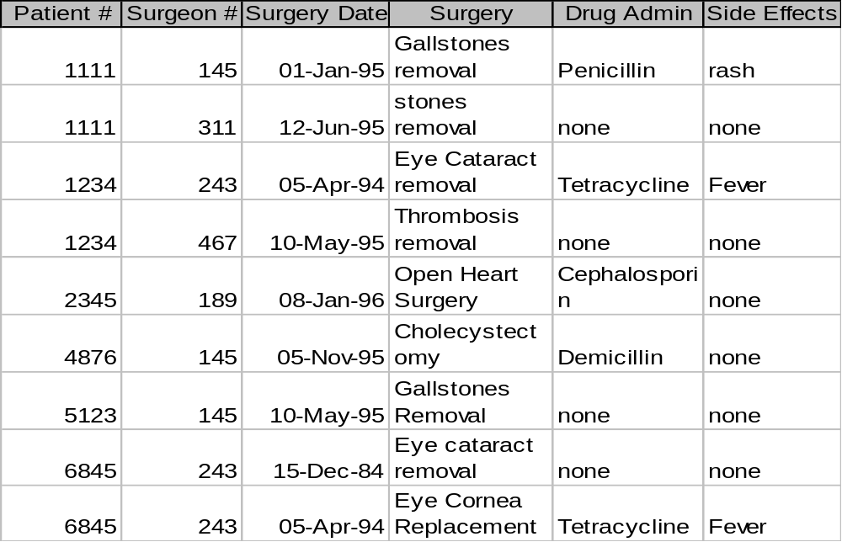
Second Normal Form
IS 257 – Fall 2006

Slide 34
1NF Storage Anomalies Removed
Insertion: Can now enter new patients without surgery.
Insertion: Can now enter Surgeons who haven’t operated.
Deletion (type 1): If Charles Brown dies the corresponding tuples from Patient and Surgery tables can be deleted without losing information on David Rosen.
Update: If John White comes in for third time, and has moved, we only need to change the Patient table
IS 257 – Fall 2006

Slide 35
2NF Storage Anomalies
Insertion: Cannot enter the fact that a particular drug has a particular side effect unless it is given to a patient.
Deletion: If John White receives some other drug because of the penicillin rash, and a new drug and side effect are entered, we lose the information that penicillin can cause a rash
Update: If drug side effects change (a new formula) we have to update multiple occurrences of side effects.
IS 257 – Fall 2006

Slide 36
Third Normal Form
A relation is said to be in Third Normal Form if there is no transitive functional dependency between nonkey attributes
  When one nonkey attribute can be determined with one or more nonkey attributes there is said to be a transitive functional dependency.
The side effect column in the Surgery table is determined by the drug administered
  Side effect is transitively functionally dependent on drug so Surgery is not 3NF
IS 257 – Fall 2006

Slide 37
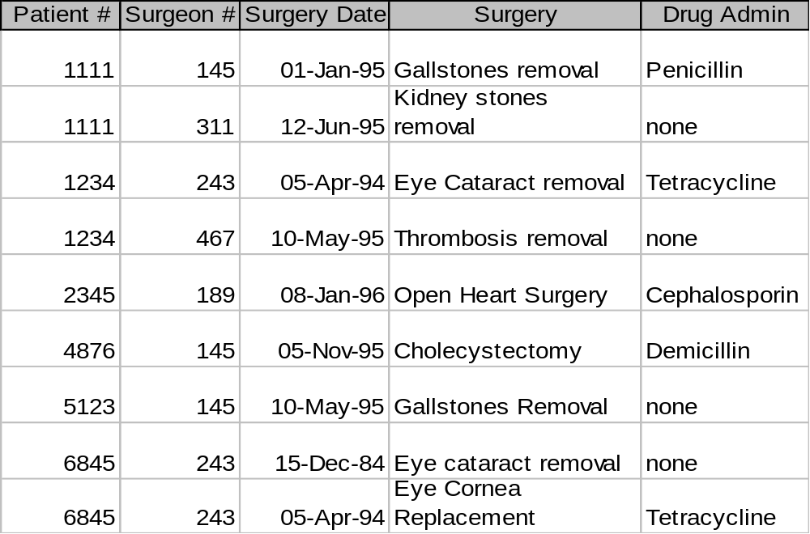
Third Normal Form
IS 257 – Fall 2006

Slide 38
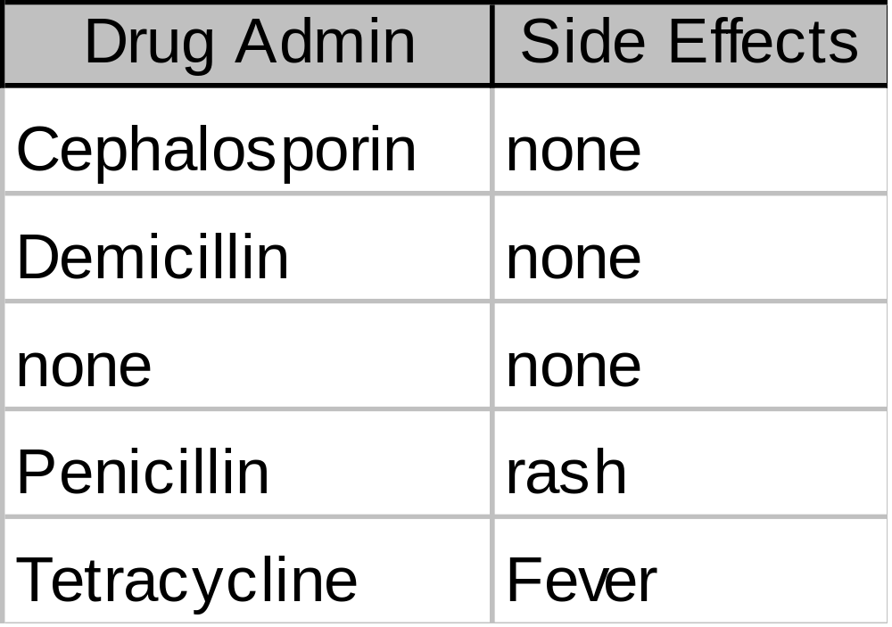
Third Normal Form
IS 257 – Fall 2006

Slide 39
2NF Storage Anomalies Removed
Insertion: We can now enter the fact that a particular drug has a particular side effect in the Drug relation.
Deletion: If John White recieves some other drug as a result of the rash from penicillin, but the information on penicillin and rash is maintained.
Update: The side effects for each drug appear only once.
IS 257 – Fall 2006

Slide 40
Boyce-Codd Normal Form
Most 3NF relations are also BCNF relations.
A 3NF relation is NOT in BCNF if:
  Candidate keys in the relation are composite keys (they are not single attributes)
  There is more than one candidate key in the relation, and
  The keys are not disjoint, that is, some attributes in the keys are common
IS 257 – Fall 2006

Slide 41

Most 3NF Relations are also BCNF – Is this one?
IS 257 – Fall 2006

Slide 42
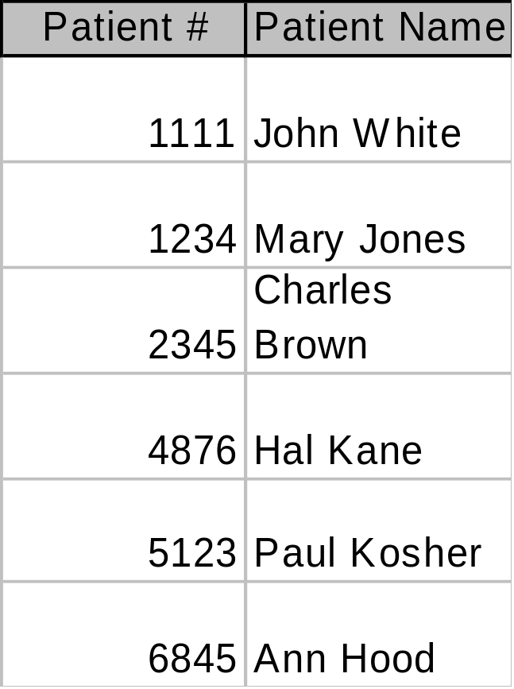
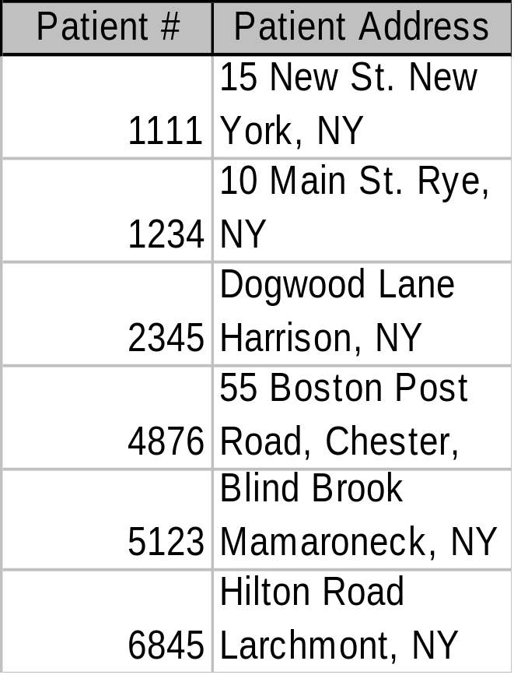
BCNF Relations
IS 257 – Fall 2006

Slide 43
Fourth Normal Form
Any relation is in Fourth Normal Form if it is BCNF and any multivalued dependencies are trivial
Eliminate non-trivial multivalued dependencies by projecting into simpler tables
IS 257 – Fall 2006

Slide 44
Fifth Normal Form
A relation is in 5NF if every join dependency in the relation is implied by the keys of the relation
Implies that relations that have been decomposed in previous NF can be recombined via natural joins to recreate the original relation.
IS 257 – Fall 2006

Slide 45
Effectiveness and Efficiency Issues for DBMS
Focus on the relational model
Any column in a relational database can be searched for values.
To improve efficiency indexes using storage structures such as BTrees and Hashing are used
But many useful functions are not indexable and require complete scans of the the database
IS 257 – Fall 2006

Slide 46
Example: Text Fields
In conventional RDBMS, when a text field is indexed, only exact matching of the text field contents (or Greater-than and Less-than).
  Can search for individual words using pattern matching, but a full scan is required.
Text searching is still done best (and fastest) by specialized text search programs (Search Engines) that we will look at more later.
IS 257 – Fall 2006

Slide 47
Normalization
Normalization is performed to reduce or eliminate Insertion, Deletion or Update anomalies.
However, a completely normalized database may not be the most efficient or effective implementation.
“Denormalization” is sometimes used to improve efficiency.
IS 257 – Fall 2006

Slide 48
Normalizing to death
Normalization splits database information across multiple tables.
To retrieve complete information from a normalized database, the JOIN operation must be used.
JOIN tends to be expensive in terms of processing time, and very large joins are very expensive.
IS 257 – Fall 2006

Slide 49
Downward Denormalization
Before:
Customer
ID
Address
Name
Telephone
After:
Customer
ID
Address
Name
Telephone
Order
Order No
Date Taken
Date Dispatched
Date Invoiced
Cust ID
Order
Order No
Date Taken
Date Dispatched
Date Invoiced
Cust ID
Cust Name
IS 257 – Fall 2006

Slide 50
Upward Denormalization
Order
Order No
Date Taken
Date Dispatched
Date Invoiced
Cust ID
Cust Name
Order
Order No
Date Taken
Date Dispatched
Date Invoiced
Cust ID
Cust Name
Order Price
Order Item
Order No
Item No
Item Price
Num Ordered
Order Item
Order No
Item No
Item Price
Num Ordered
IS 257 – Fall 2006

Slide 51
Denormalization
Usually driven by the need to improve query speed
Query speed is improved at the expense of more complex or problematic DML (Data manipulation language) for updates, deletions and insertions.
IS 257 – Fall 2006

Slide 52
Using RDBMS to help normalize
Example database: Cookie
Database of books, libraries, publisher and holding information for a shared (union) catalog
IS 257 – Fall 2006

Slide 53
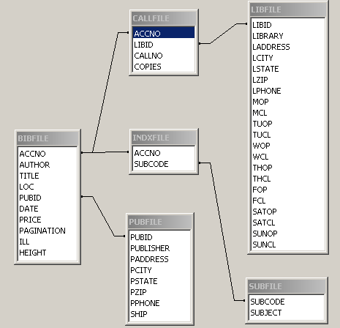
Cookie relationships
IS 257 – Fall 2006

Slide 54
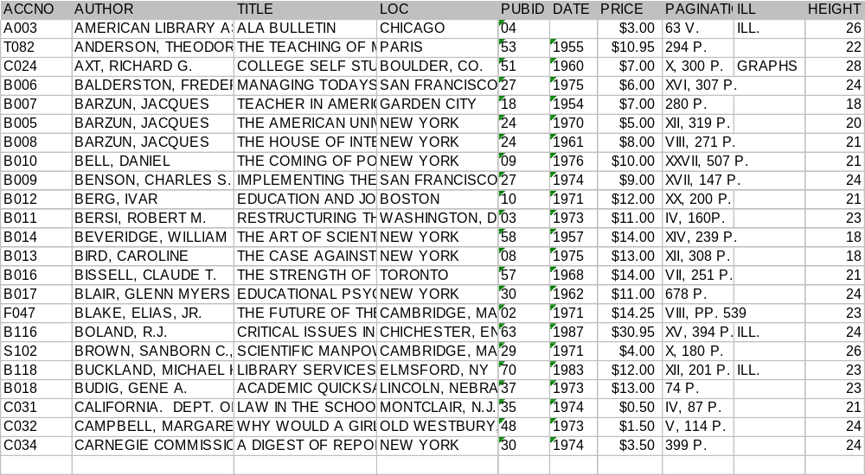
Cookie BIBFILE relation
IS 257 – Fall 2006

Slide 55
How to Normalize?
Currently no way to have multiple authors for a given book, and there is duplicate data spread over the BIBFILE table
Can we use the DBMS to help us normalize?
Access example…
IS 257 – Fall 2006

Slide 56
Database Creation in Access
Simplest to use a design view
  wizards are available, but less flexible
Need to watch the default values
Helps to know what the primary key is, or if one is to be created automatically
  Automatic creation is more complex in other RDBMS and ORDBMS
Need to make decision about the physical storage of the data
IS 257 – Fall 2006

Slide 57
Database Creation in Access
Some Simple Examples
IS 257 – Fall 2006

Slide 58
Lecture Outline
Review
Logical Model for the Diveshop database
Normalization
Relational Advantages and Disadvantages
IS 257 – Fall 2006

Slide 59
Advantages of RDBMS
Relational Database Management Systems (RDBMS)
Possible to design complex data storage and retrieval systems with ease (and without conventional programming).
Support for ACID transactions
  Atomic
  Consistent
  Independent
  Durable
IS 257 – Fall 2006

Slide 60
Advantages of RDBMS
Support for very large databases
Automatic optimization of searching (when possible)
RDBMS have a simple view of the database that conforms to much of the data used in business
Standard query language (SQL)
IS 257 – Fall 2006

Slide 61
Disadvantages of RDBMS
Until recently, no real support for complex objects such as documents, video, images, spatial or time-series data. (ORDBMS add -- or make available support for these)
Often poor support for storage of complex objects from OOP languages (Disassembling the car to park it in the garage)
Usually no efficient and effective integrated support for things like text searching within fields (MySQL does have simple keyword searching now with index support)
IS 257 – Fall 2006

Slide 62
Next Week
Database Design Workshop
IS 257 – Fall 2006

